Slide 1
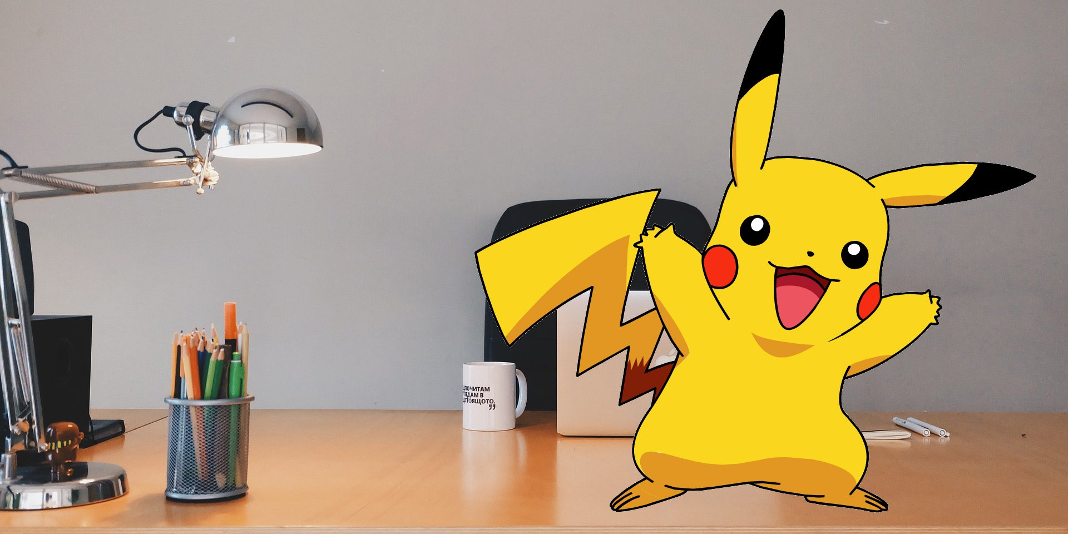
Starter Unit

Slide 2
Did you finish your homework?

Slide 3
Choose the English bee
Ask Teacher Mandy before the English class.
Hand out English homework.
Report who’s absent.

Slide 5
(a/an)ant

Slide 6
(a/an)bird

Slide 7
(a/an)cat

Slide 8
(a/an)dog

Slide 9
(a/an)elephant

Slide 10
(a/an)fish

Slide 11
(a/an)gorilla

Slide 12
(a/an)horse

Slide 13
(a/an)iguana

Slide 14
(a/an)jelly fish

Slide 15
(a/an)koala

Slide 16
(a/an)lion

Slide 17
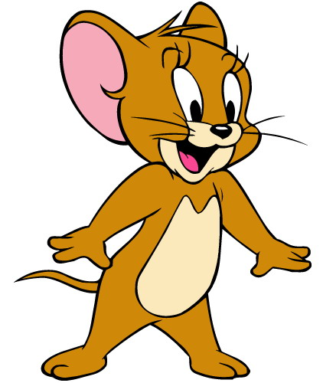
(a/an)mouse

Slide 18
(a/an) nightingale

Slide 19
(a/an)octopus

Slide 20
(a/an)penguin

Slide 21
(a/an)queen

Slide 22
(a/an)rabbit

Slide 23
(a/an)snake

Slide 24
(a/an)turtle

Slide 25
(a/an) Uakari

Slide 26
(a/an)vulture

Slide 27
(a/an)whale

Slide 28
(a/an)xeme

Slide 29
(a/an)yak

Slide 30
(a/an)zebra

Slide 31
Let’s make new friends in Dino On the Go3!

Slide 32
Listen!!!!!!!

Slide 33
mom Dino Danny Irene Niki Owen Miss Lee
________: Good morning!
I’m Dino. I can swim, and I like apples.
________: Hi, I’m Danny. I’m Niki’s brother. I can draw.
________: Hello, I’m Irene. I like papayas.
Dino
Danny
Irene

Slide 34
Niki
________: Hi, my name is Niki. I love school.
________: Hello, I’m Owen. I can dance.
Danny’s ______: Hello, kids. I’m Danny and Niki’s mom.
________: Good morning, everyone. I’m Miss Lee.
Owen
mom
Miss Lee

Slide 35
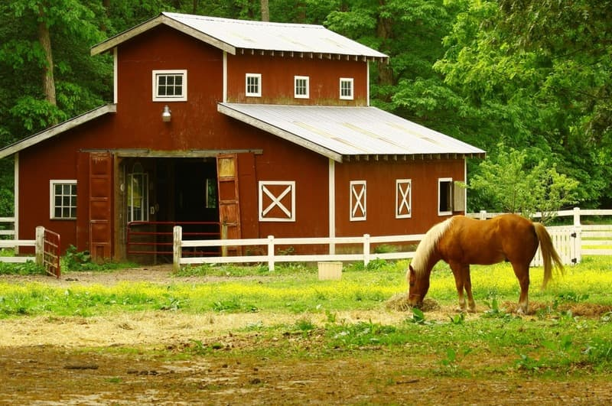
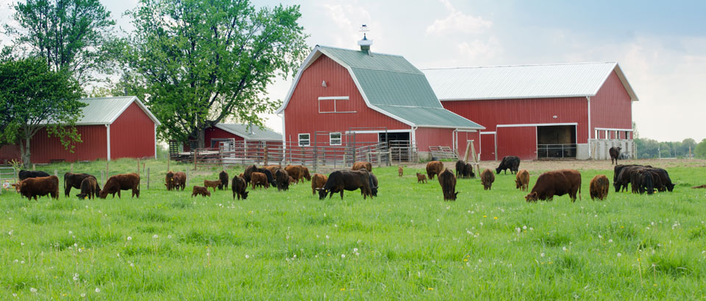
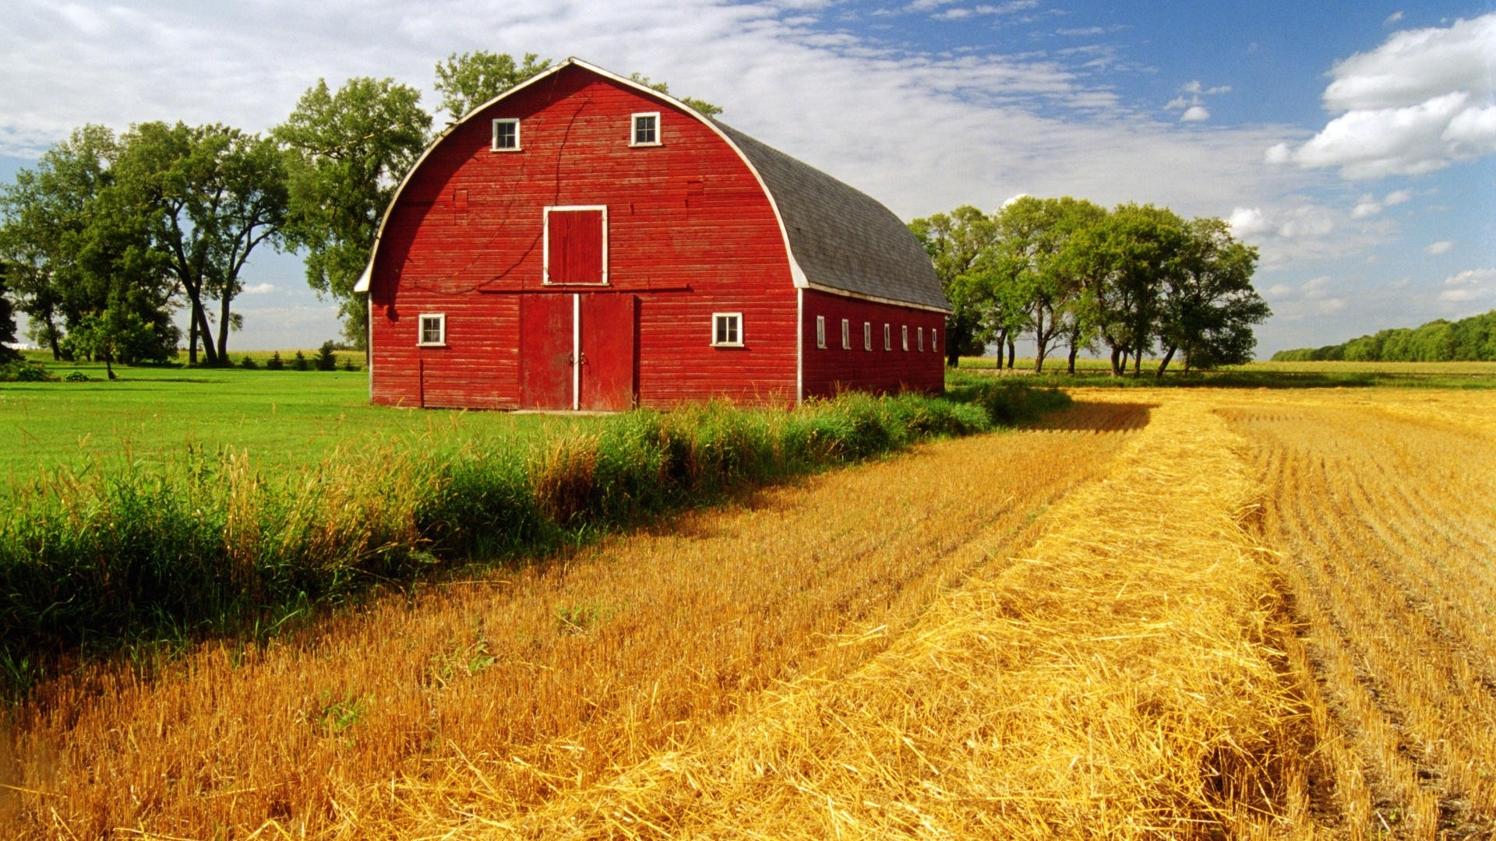
Vocabulary 1
farm

Slide 36
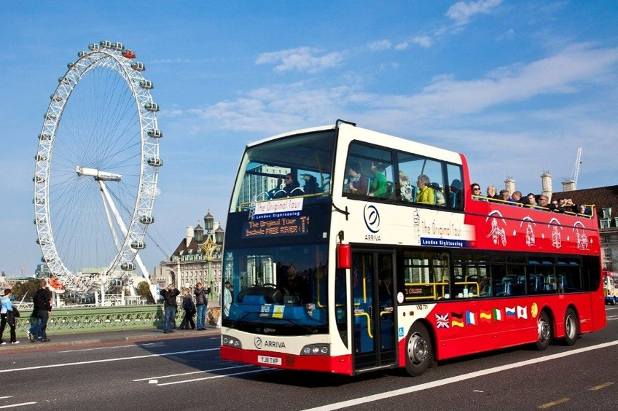
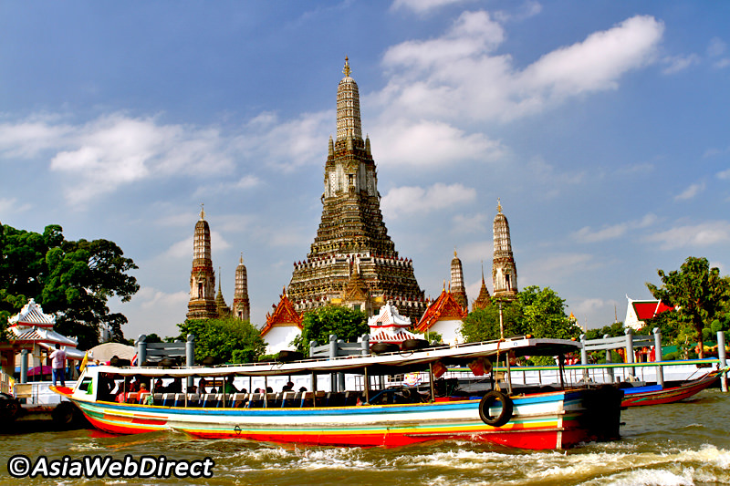
Vocabulary 2
tour

Slide 37
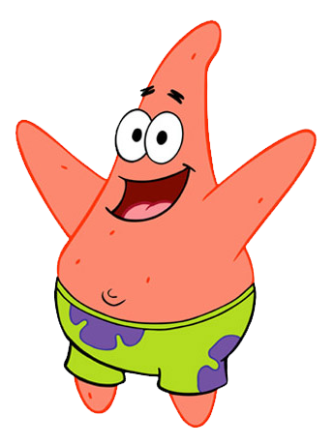
Turn to page 1

